Slide 1



CROWD FUNDING
PROJECT
MODULES: EXCEL, TABLEAU,POWER BI &SQL

Slide 2
TABLE OF CONTENTS
01
INTRODUCTION
02
KEY PERFORMANCE INDICATORS(KPIS)
03
SQL QUERIES AND RESULTS
04
EXCEL DASHBOARD
05
POWER BI ANALYSIS
06
TABLEAU VISUALIZATION
07
CHALLENGES FACED
08
CONCLUSION
09
THANKYOU

Slide 3




PROJECT OVERVIEW & OBJECTIVES
Crowdfunding is the practice of funding a project
or venture by raising small amounts of money from
a large number of people, typically via the Internet.
The objective of the project is to provide actionable insights while also conducting an analysis of key performance metrics.
In order to accomplish eight different tasks with a single tool and offer insights, we began with Excel and SQL, then moved on to Power BI and Tableau in subsequent weeks.

Slide 4

KPIS OVERVIEW
The key KPIs for the crowdfunding project included Funds Raised, which tracked the total amount raised compared to the campaign’s goal, and Backer Demographics, providing insights into donor location, age, and frequency. The Conversion Rate measured how effectively the campaign turned visitors into donors, while the Average Donation indicated the typical contribution per backer.
Campaign Progress tracked the percentage of the fundraising goal achieved over time, and Donation Method Breakdown provided insights into which payment methods were most popular.
Finally, Backer Retention measured the percentage of repeat backers, helping assess long-term donor engagement. These KPIs were essential for evaluating campaign performance, optimizing strategies, and ensuring fundraising objectives were met.

Slide 5

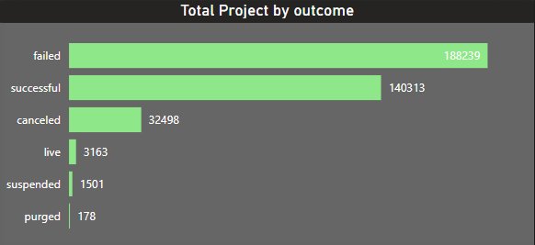
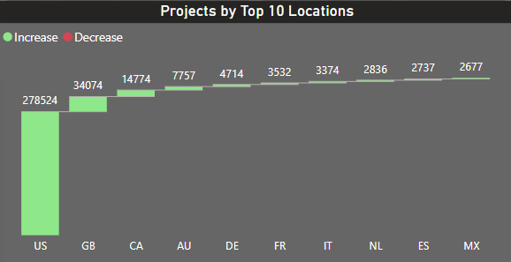
TOTAL NUMBER OF PROJECTS BASED ON OUTCOME AND
BY TOP 10 LOCATIONS
Total number of successful projects are 140313 whereas failed projects are more in number i.e. 188239
Overall, the projects which are failed are more in number when compared to the other outcomes.
The United states contribution for the projects is more than the other countries. The total projects from United States are 278524
Next top number of projects are from Great Britain and California.

Slide 6
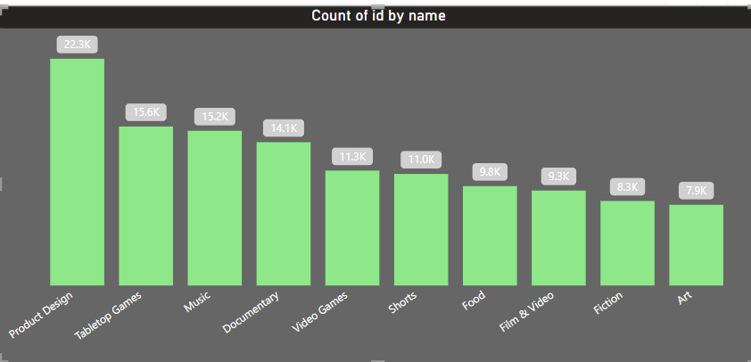
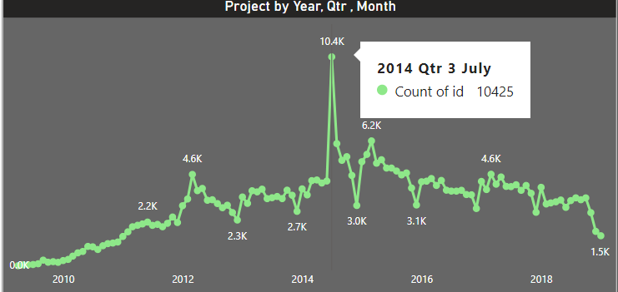
TOTAL NUMBER OF PROJECTS BASED ON CATEGORY
AND BY YEARS,QTR,MONTH
High number of projects are in Product Design category followed by Tabletop games.
In the year, 2014, 3ʳᵈ Quarter, July month we have high number of projects when compared to other years.

Slide 7
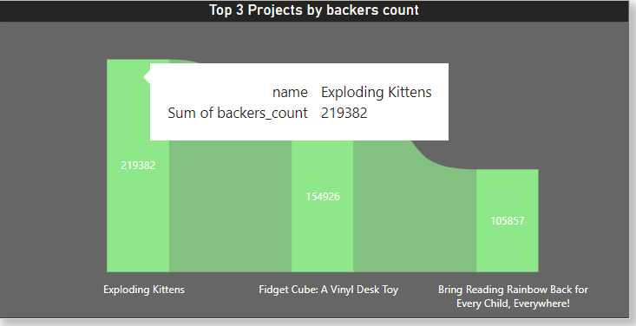
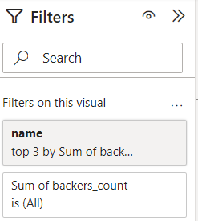
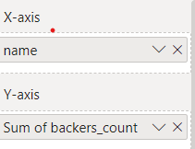
TOP SUCCESSFUL PROJECTS Based on Number of Backers
Exploding kittens, project has highest number of backers.

Slide 8
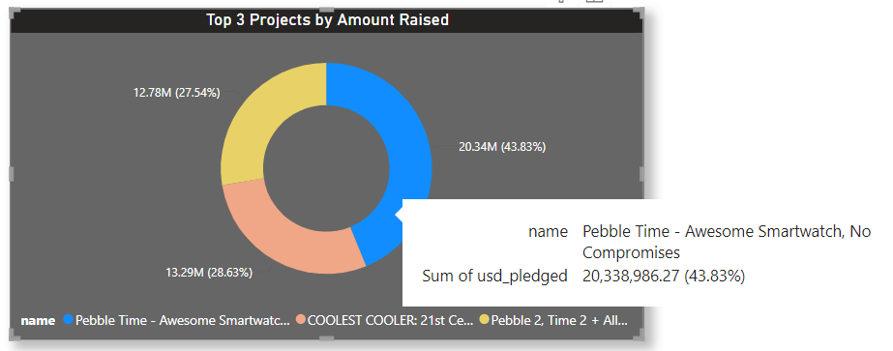
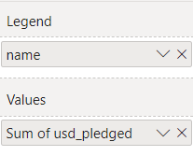
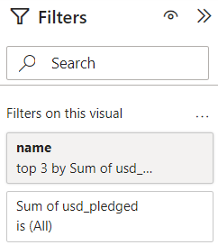
TOP SUCCESSFUL PROJECTS BASED ON AMOUNT RAISED
Pebble Time-Awesome Smartwatch, No compromises has the highest amount raised

Slide 9
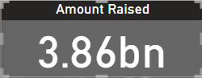
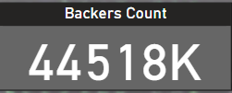
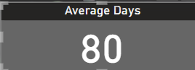
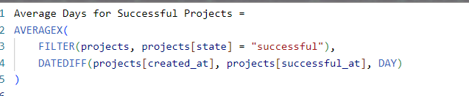
AMOUNT RAISED, BACKER’S COUNT &
AVERAGE NUMBER OF DAYS FOR SUCCESSFUL PROJECTS
By calculating the sum of usd_pledged we can get identify that the total amount raised for the projects is $3.86 billion
Total number of backer’s are 44 million518 thousands
The average number of days for successful project are 80 days

Slide 10
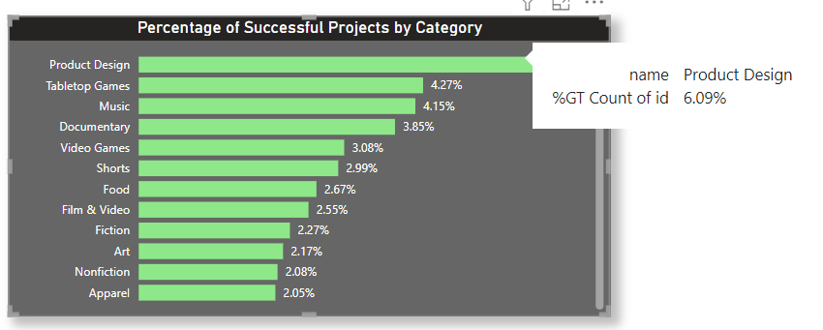
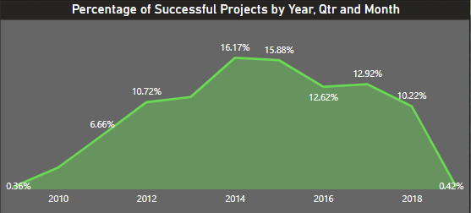
TOP SUCCESSFUL PROJECTS IN % BASED ON CATEGORY AND
BY YEAR QTR AND MONTH
The category Product Design has the highest percentage of successful projects followed by Tabletop games and Music
In 2014, we have highest percentage of successful projects when compared to other years.
From year 2010, we can see increase in percentage but after 2015 the percentage is gradually decreasing.

Slide 11
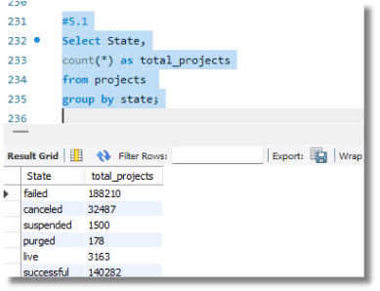
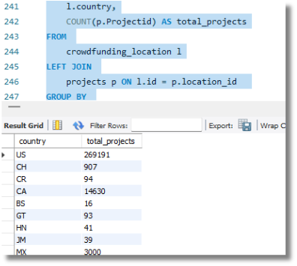
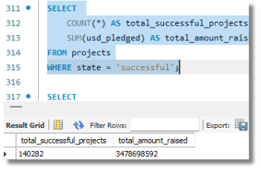
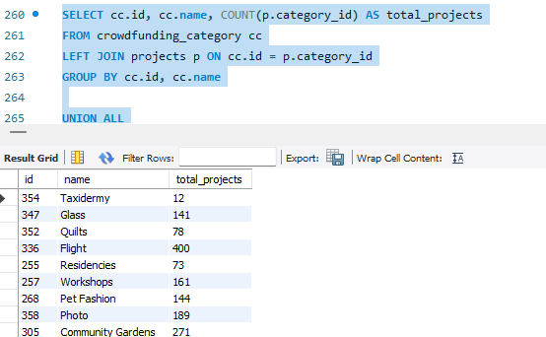
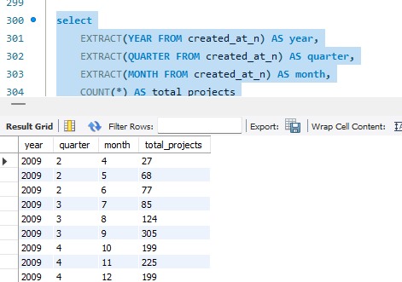
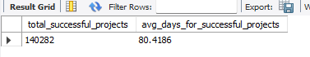
SQL QUERY FOR KPI CALCULATION
This query would help to calculate the total funds raised per campaign or per category over a specified time period (e.g., the last quarter). The query would aggregate data from contributions or backer transactions, grouping them by campaign or crowdfunding category (such as technology, arts, or charity), and provide insights into how much funding each campaign or category has received.

Slide 12
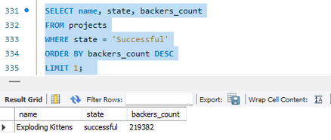
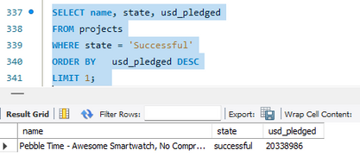
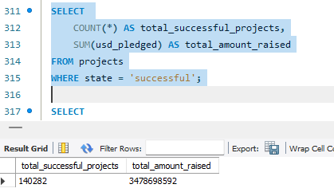
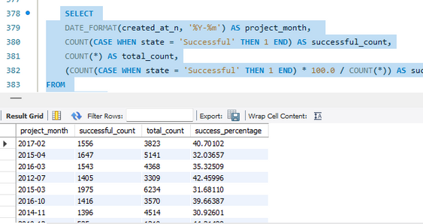
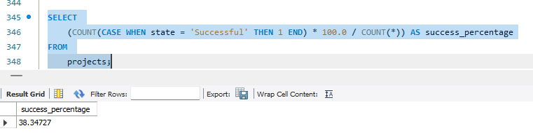
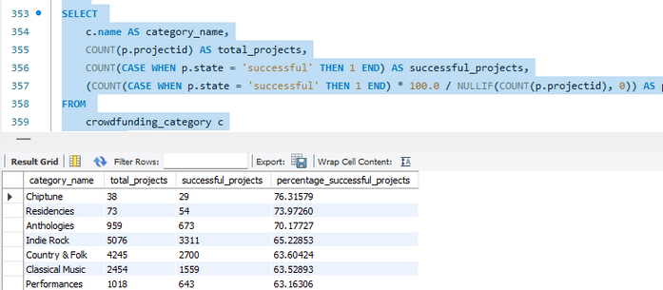
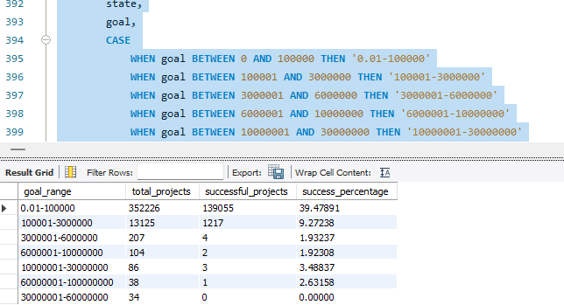
SQL QUERY FOR KPI CALCULATION
In summary, the query would help analyze the financial success of crowdfunding campaigns by summarizing the total funds raised across various campaigns or categories within a given period. This provides valuable insights into campaign performance, donor behavior, and market trends within the crowdfunding ecosystem.

Slide 13
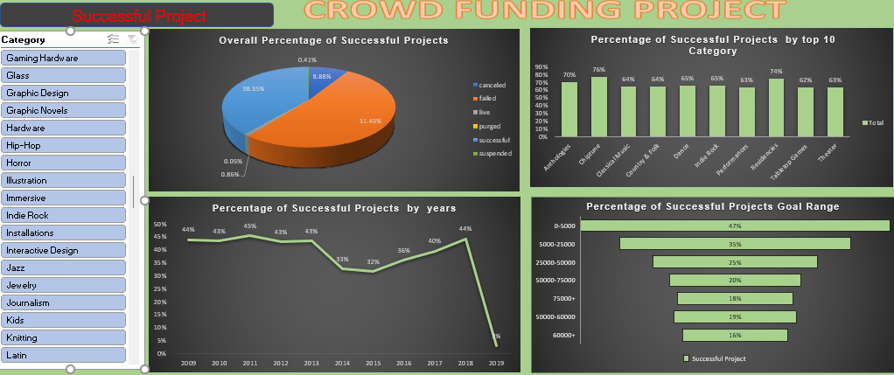
EXCEL DASHBOARD OVERVIEW
An Excel dashboard for crowdfunding projects consolidates key metrics such as funds raised, backer demographics, campaign performance, and project progress into a single, easy-to-understand visual interface. By utilizing Pivot Tables, formulas, and charts, this dashboard enables effective analysis and summarization of crowdfunding data.

Slide 14
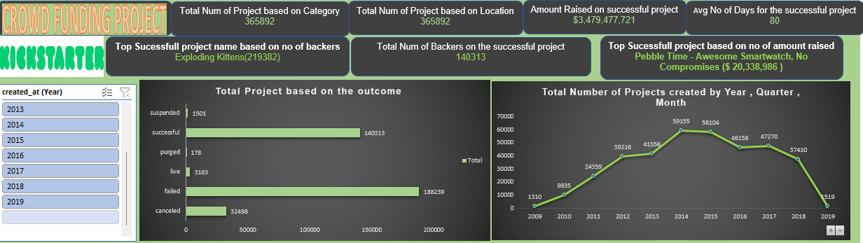
EXCEL DASHBOARD OVERVIEW
When building an Excel dashboard for crowdfunding projects, several key features can enhance its functionality and interactivity, enabling users to drill down into the data for more detailed insights. Together, these features create a comprehensive, user-friendly dashboard that empowers crowdfunding managers to track project performance, monitor fundraising progress, and make informed, data-driven decisions.

Slide 15
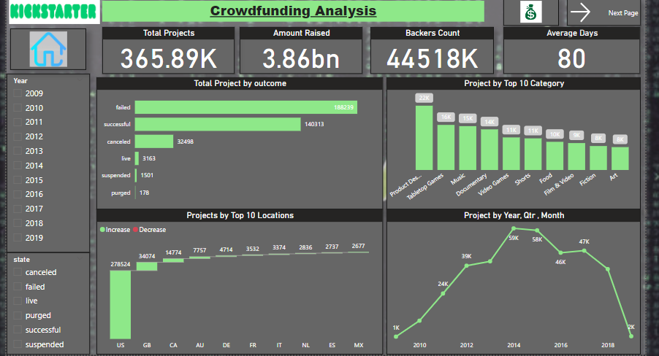
POWER BI DASHBOARD OVERVIEW
In the crowdfunding project, Power BI was used to create a dynamic and interactive dashboard that visualizes key metrics, making it easier for project managers and stakeholders to analyze and monitor the campaign performance. Power BI offers advanced features such as data modeling, real-time updates, and interactive visualizations, making it an ideal tool for this type of analysis.

Slide 16
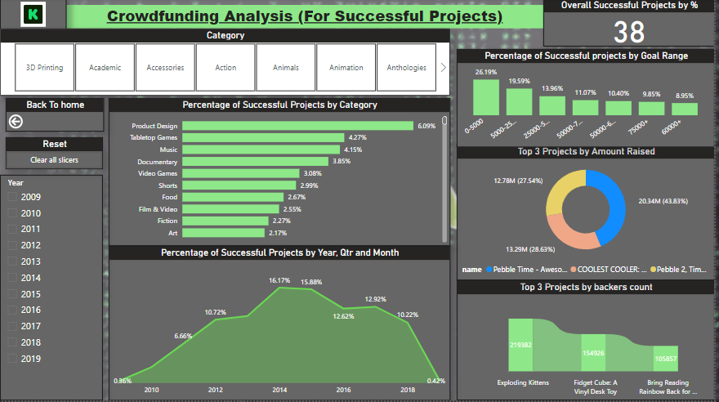
POWER BI DASHBOARD OVERVIEW
By using Power BI in the crowdfunding project, the dashboard provided a rich, interactive environment for analyzing and visualizing data. With a combination of bar charts, line graphs, KPIs, pie charts, and other visualizations, the dashboard allowed users to quickly assess campaign performance, track funds raised, and make informed decisions. The interactive filters, drill-through options, and real-time data refresh made the dashboard a dynamic tool for crowdfunding managers, helping them drive successful campaigns through data-driven insights.

Slide 17
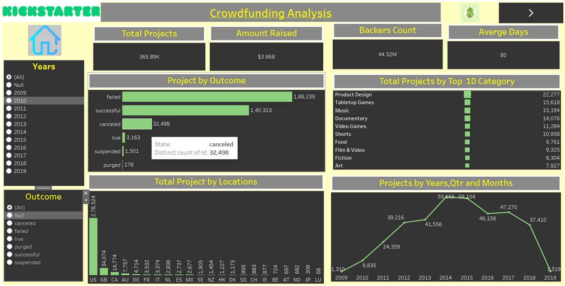
TABLEAU VISUALIZATIONS OVERVIEW
In a Tableau dashboard for crowdfunding projects, several interactive elements were implemented to enhance the analysis process and make the dashboard more engaging for users. These features allowed users to explore data dynamically, dive deeper into specific metrics, and gain a more comprehensive understanding of campaign performance.

Slide 18
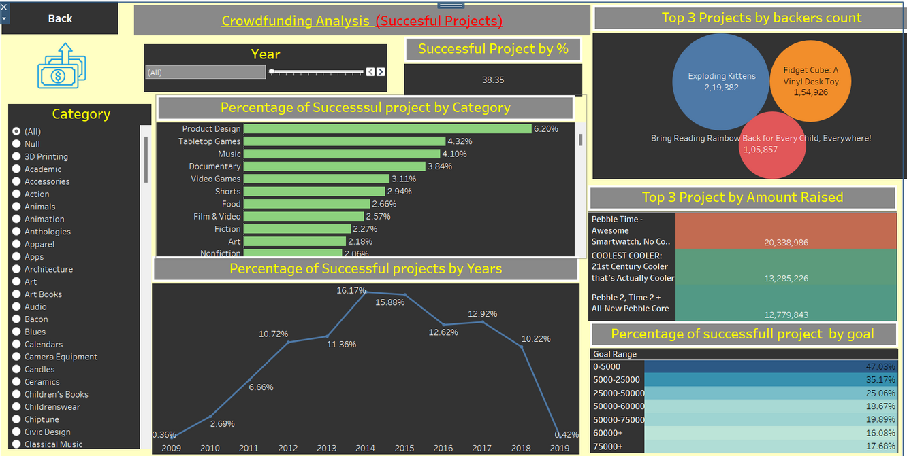
TABLEAU VISUALIZATIONS OVERVIEW
Interactive elements in Tableau, such as filters, drill-throughs, tooltips, dynamic filtering, dashboard actions, parameters for what-if analysis, and geospatial mapping, significantly enhanced the crowdfunding project’s dashboard. These features provided users with the flexibility to explore the data from different perspectives, dive deeper into key metrics, and easily compare different campaigns or regions. Tableau’s powerful visualization and interactivity features empowered crowdfunding managers to make informed, data-driven decisions, track performance more effectively, and optimize future fundraising strategies.

Slide 19





CHALLENGES ENCOUNTERED
Technical Challenges
Solutions/ Workaround
SQL Data Loading Errors: We encountered issues while loading data from the SQL database due to data structure was huge and slow query execution.
This was resolved by optimizing SQL queries and cleaning the data before import.
The slicers were not filtering data correctly due to mis linked fields in the data model
We fixed this by reconfiguring the slicers to properly connect to the relevant data, restoring full functionality.

Slide 20

CONCLUSIONS AND KEY TAKEAWAYS
Next steps include refining targeted marketing, optimizing campaign timing, enhancing payment options, and improving performance forecasting to boost future campaign success.
These insights enabled more informed decision-making regarding resource allocation, marketing strategies, and overall campaign management, helping to optimize fundraising efforts and improve future project outcomes.
The project results will guide future decisions by enabling targeted marketing to high-performing regions, optimizing fundraising timing based on donation trends, improving payment systems based on donor preferences, and enhancing performance forecasting. These insights will help maximize campaign effectiveness, improve resource allocation, and increase the likelihood of meeting fundraising goals.
SUMMARY OF FINDINGS
FUTURE RECOMMENDATIONS
IMPACT OF THE PROJECT

Slide 21
THANKYOU FOR YOUR ATTENTION
For any queries please contact:
Rhishikesh Prasanna Shirudkar rhishishirudkar@gmail.com 9067827341
Gaurav Suhasrao Panchabhaiyye gpanchabhaiyye@gmail.com 7666290447
R.Sri Ramyutha ramyutha@gmail.com 9666312169
Aripilli Vasavi aripillivasavi1999@gmail.com 8328649067
Himanshu Upadhyay upadhyayhimanshu0202@outlook.com 9598951192
Anil Raykwade anilraykwade06@gmail.com 6364259466
Mohammed Farid mohdfarid786.fm@gmail.com 9768676537

